Slide 1

Hello, Yoga

Slide 2


Slide 3
VS Code / Eclipse
HTML, Java Script, jQuery, Bootstrap

Slide 4
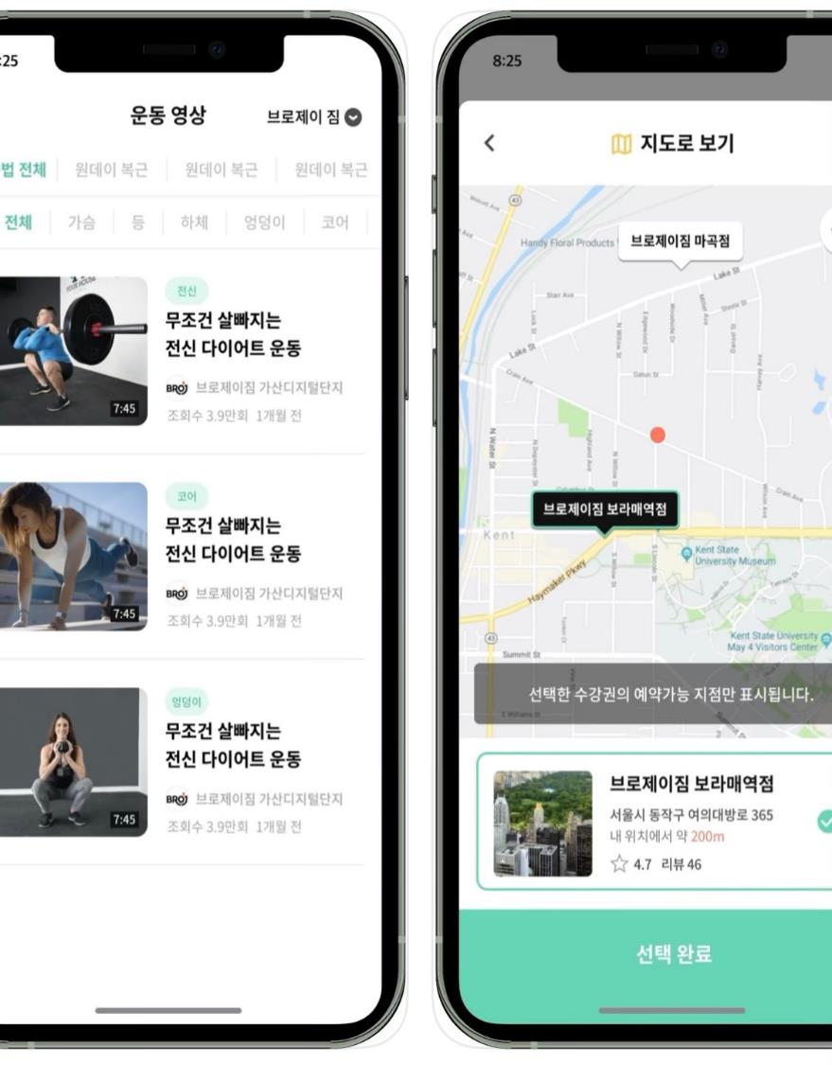

Slide 5
「
https://silverzero2.github.io/YogaSite/
」

Slide 6
01
Main Page
02
Introduce Center
Page
03
Only-Member
04
Oneday-Class
05
Review

Slide 7
Main Page

Slide 8
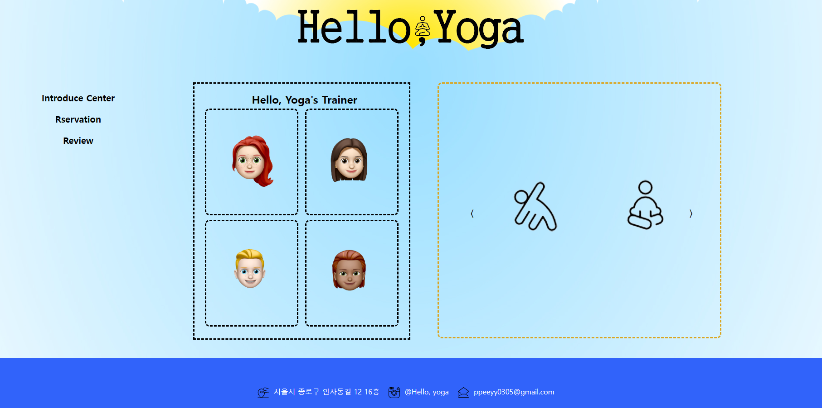

Slide 9

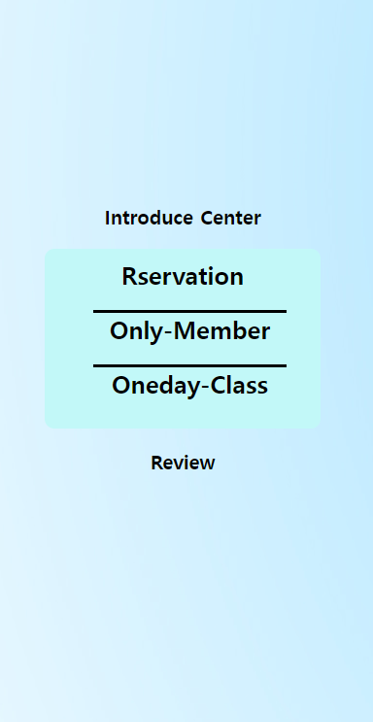

Slide 10
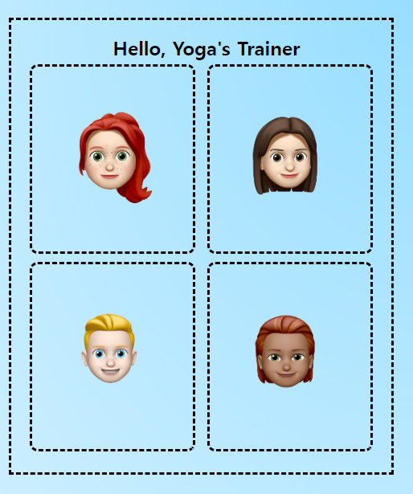
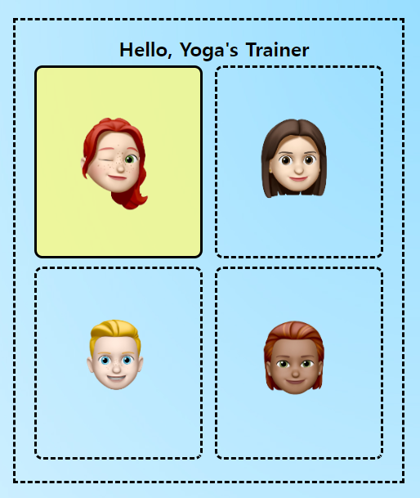

Slide 11
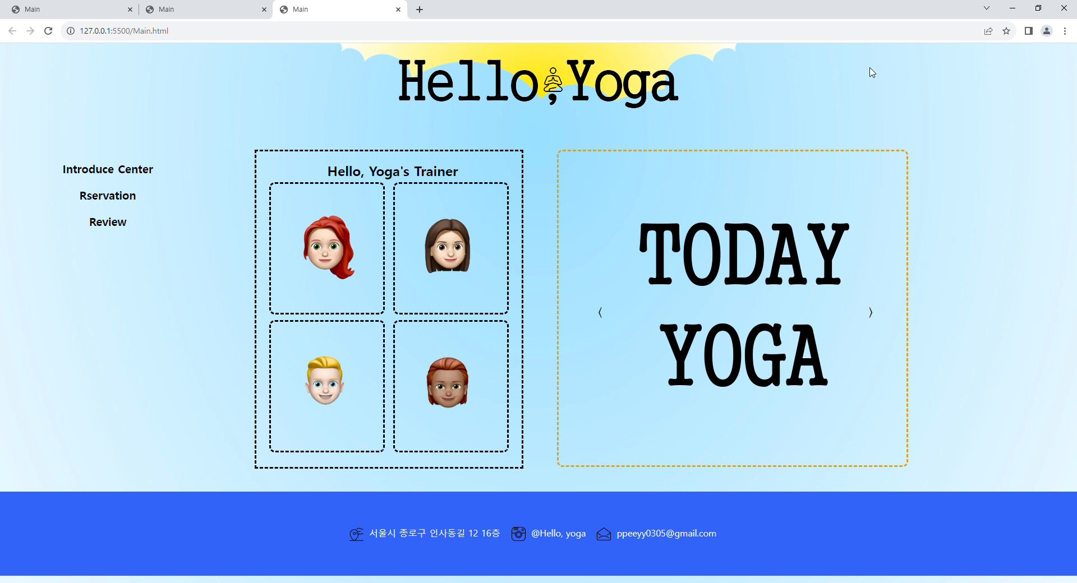

Slide 12
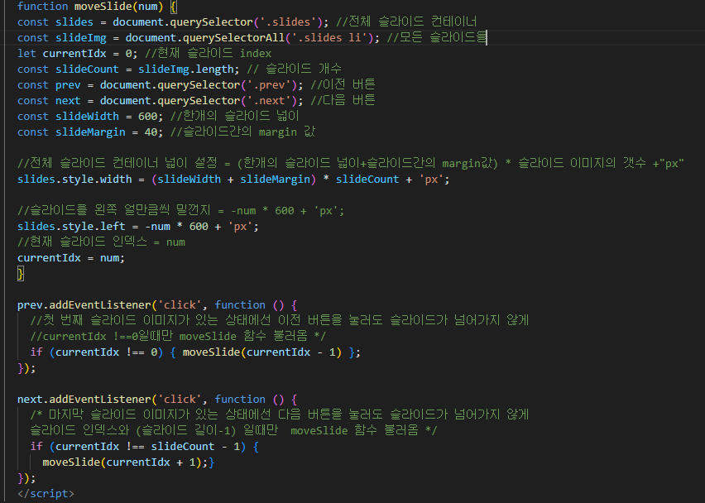

Slide 13


Slide 14
Introduce Center

Slide 15
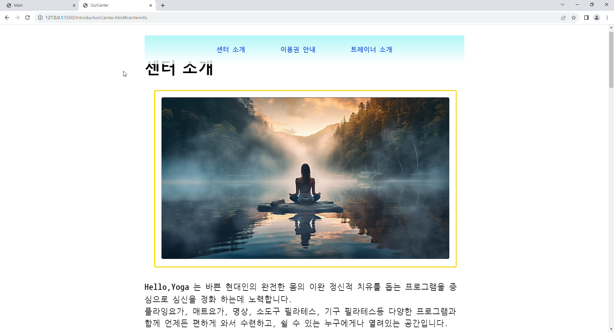

Slide 16
Only-Member

Slide 17
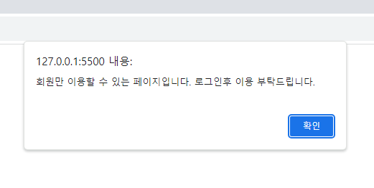
V

Slide 18
Oneday-Class

Slide 19
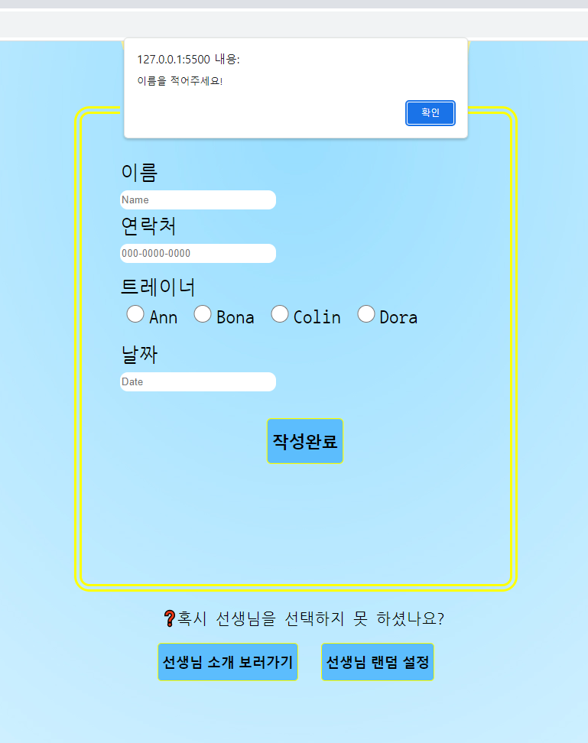
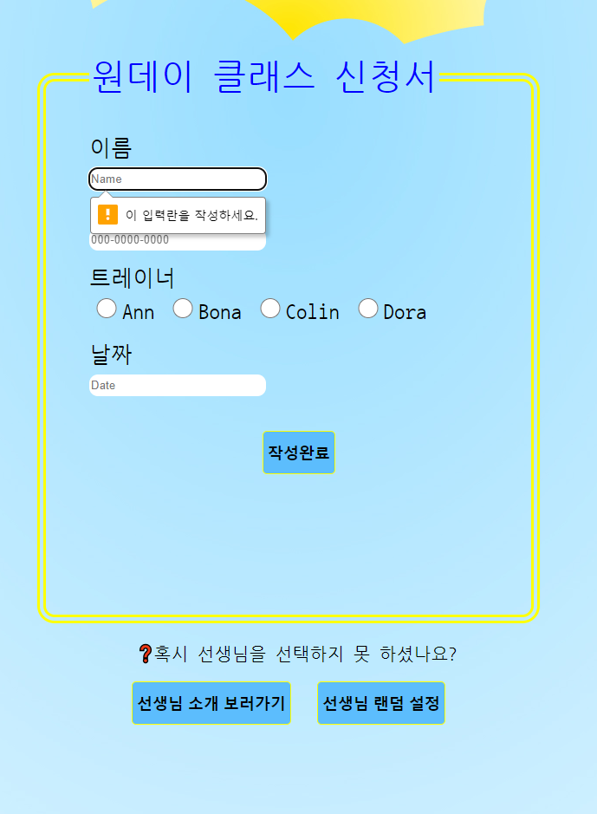

Slide 20
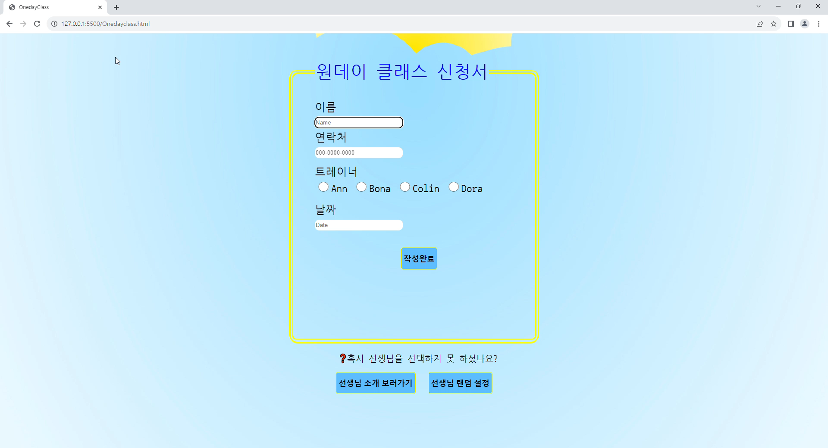

Slide 21
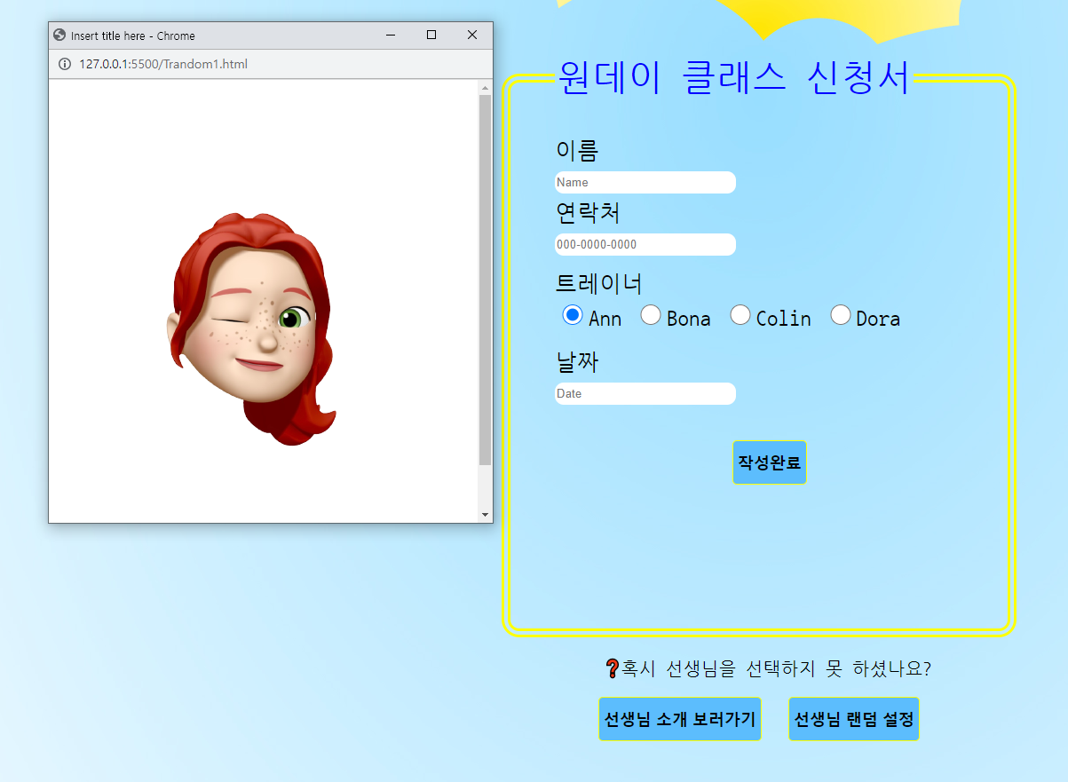

Slide 22
Review

Slide 23
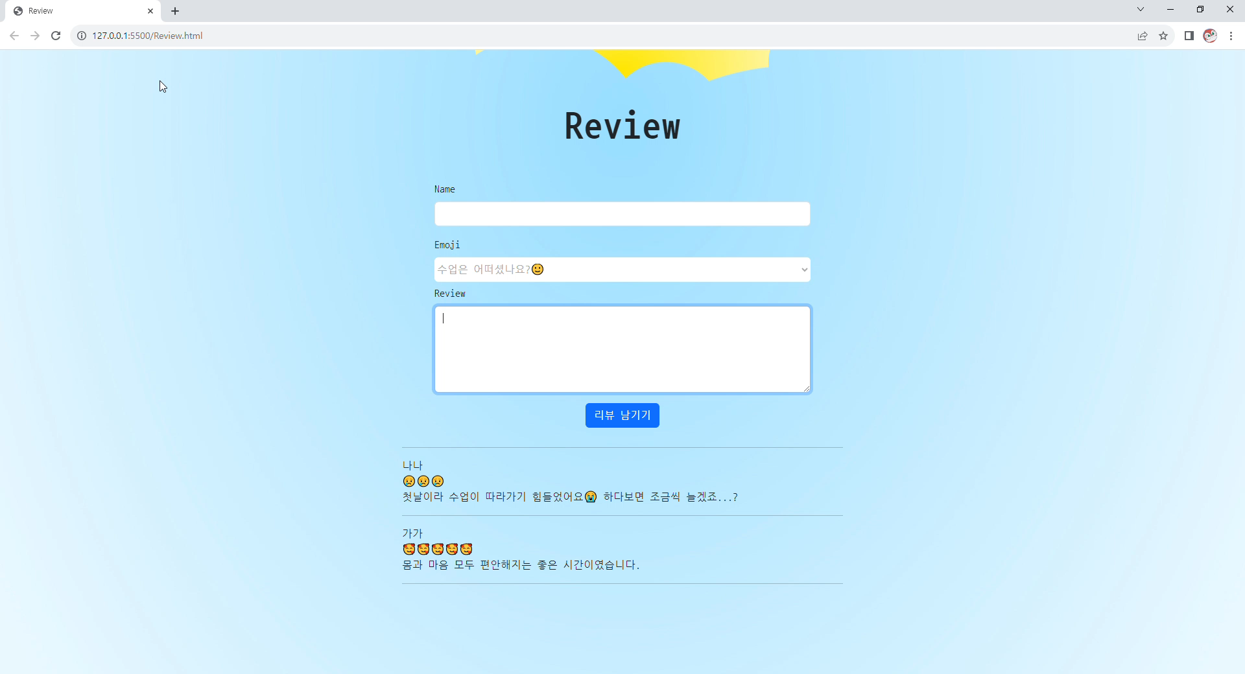
「
」

Slide 24

Q&A

Slide 25
감사합니다

